Slide 1
Overview of AI

Slide 2
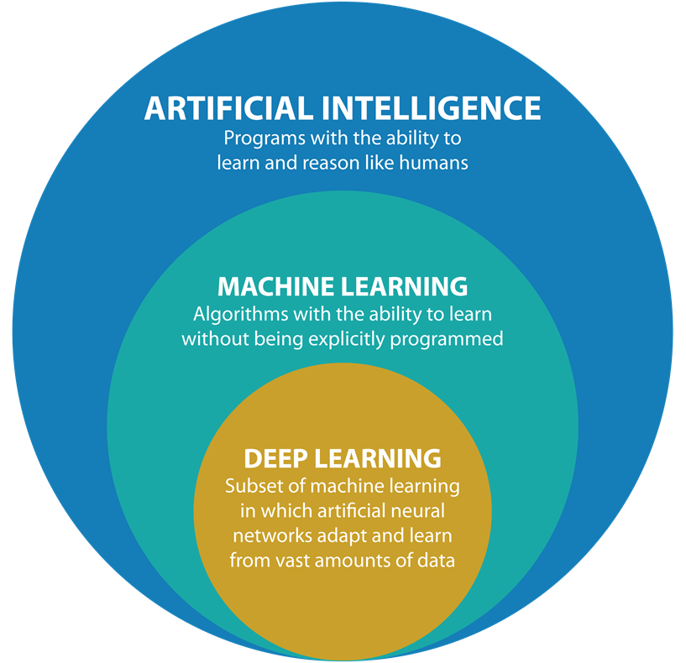
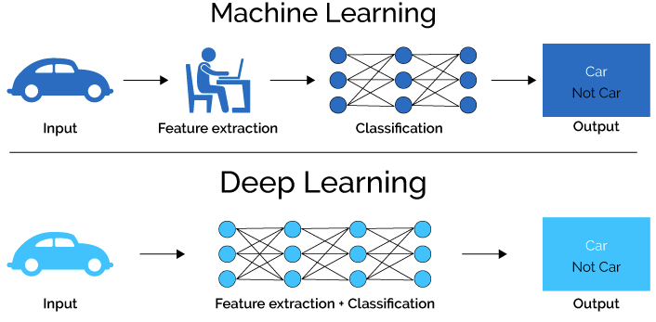
Introduction to Deep learning / AI
Intelligence: ”the ability to learn, understand and think
Source: https://www.quora.com/
Notes:
ML:
consume data
apply statistical techniques to detect patterns; and
thereby “learn” how to perform some task
DL:
consume data
thereby “learn” how to perform some task

Slide 3
Major Types
Learn from
mistakes
Data driven
Game AI
Robot Navigation
Skill acquisition
Recommendation system
Customer segmentation
Dimensionality reduction
Data Compression
Reinforcement
Learning
Unsupervised
Learning
Feedback to algorithm when it does something right/wrong
Data: reward, action
Goal: Maximize future rewards
Machine Learning
Non labeled data self organizes to predict new outcome
Data: X
Goal: Lean underlying structure
Supervised
Learning
Task driven
Pre labeled data trains a model to predict new outcome
Data: (X, Y)
Goal: Lean mapping function – X to Y

Slide 4
Major Types
Supervised
Learning
Classification
Regression
Image classification
Price prediction
Fraud detection
Discrete Response
Continues Response
Weather prediction
Text classification
Market forecasting

Slide 5
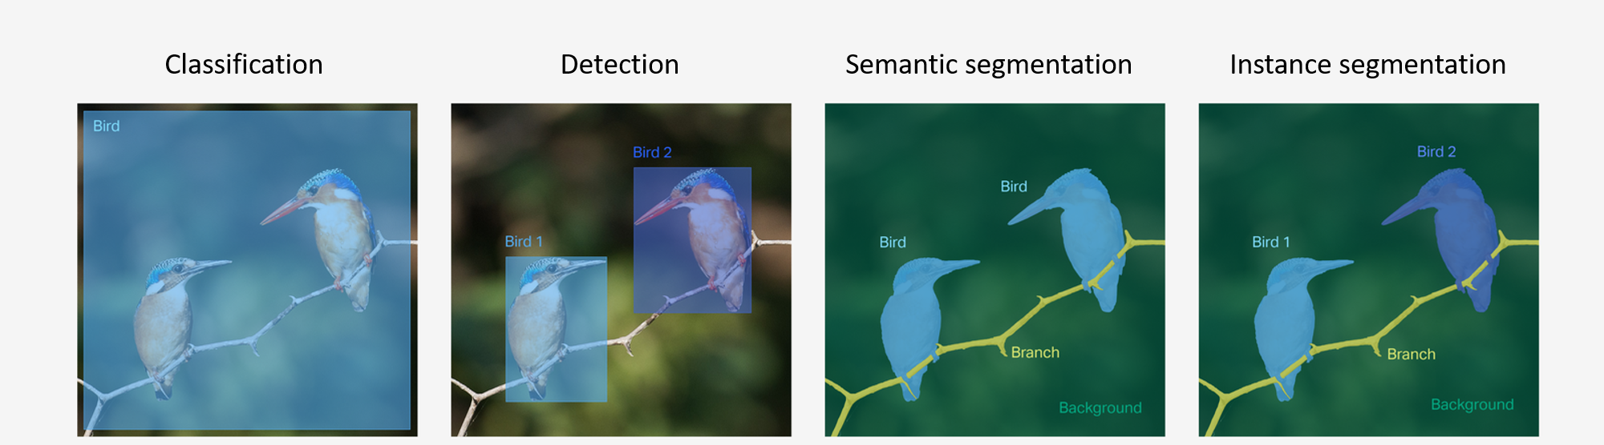
Major Types
Image
classification
Image
classification
Object
detection
Segmentation
What’s present in the image?
What’s present in the image – and where?
Image level classification
Identify multiple objects in the image
draw bounding box around the object
Classify each object into one of the category

Slide 6
Major Types
Image
classification
Image
classification
Object
detection
Segmentation
What’s present in the image?
What’s present in the image – and where?
Semantic
segmentation
Instance
Segmentation
Image level classification
Identify multiple objects in the image
draw bounding box around the object
Classify each object into one of the category
What’s present in the image at pixel level
What’s present in the image at pixel level
all pixels corresponding to a class are given the same pixel value
all pixels corresponding to each instance (or object) of a class are given unique values

Slide 7
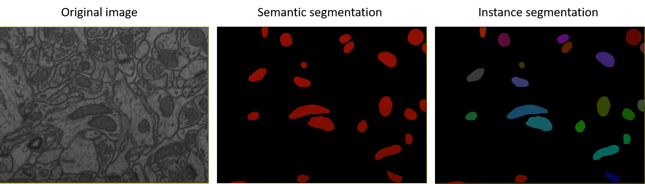
Major Types

Slide 8

Artificial Neural Network
Source: https://www.towardsdatascience.com

Slide 9
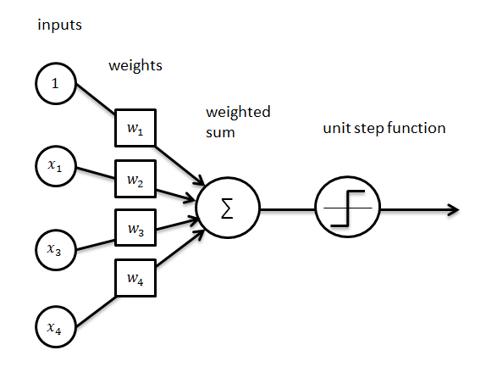
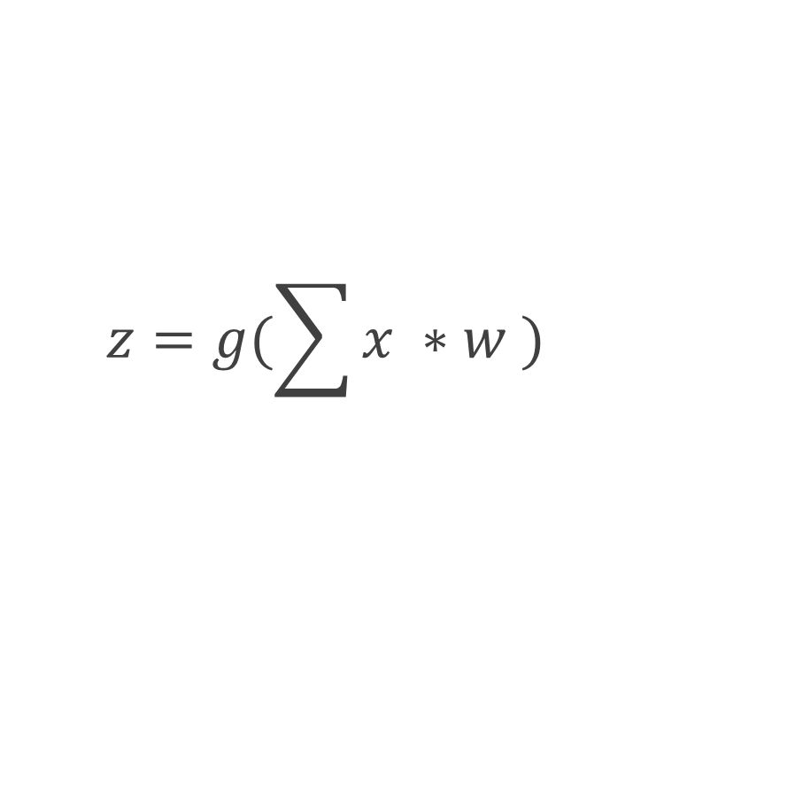
Structure of the Neuron
$$z=g(\sum{x ∗w )}$$

Slide 10
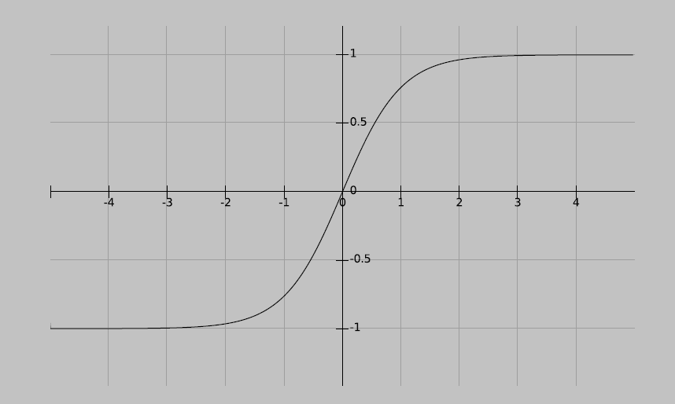
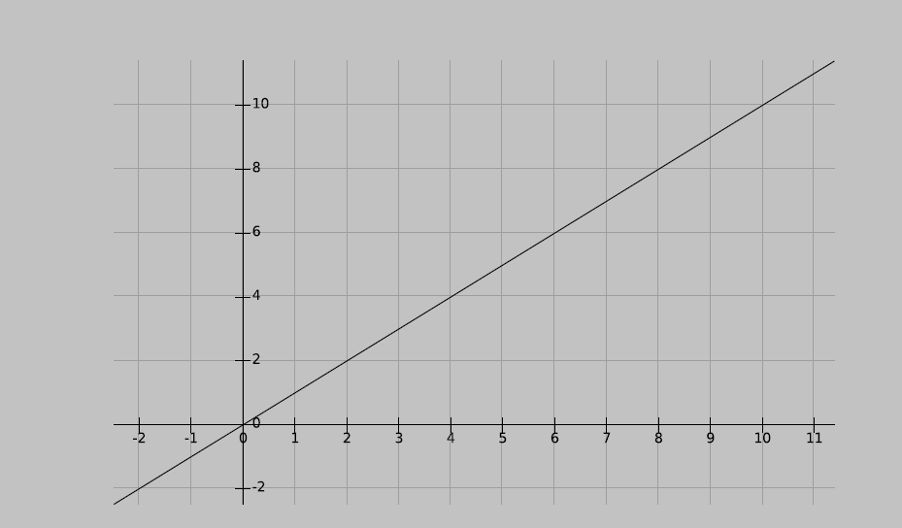
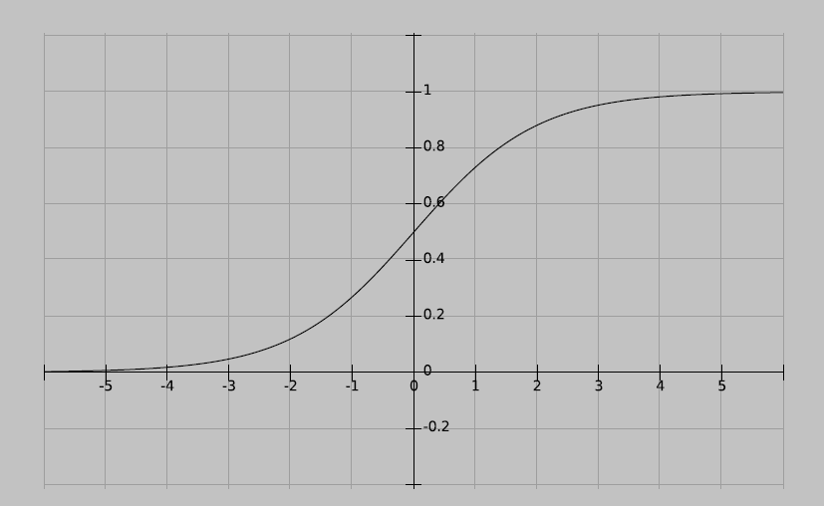
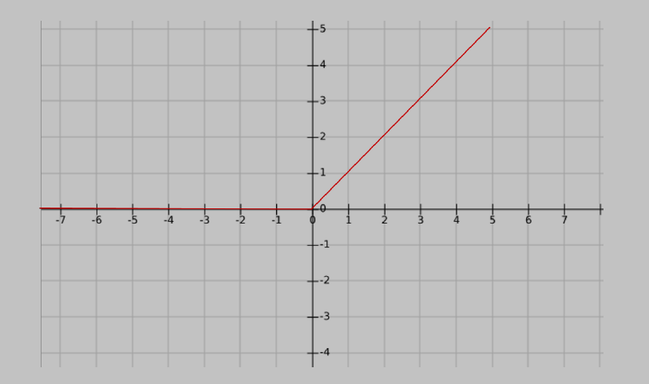
Activation functions
Defines if neuron is activated or not
Adds non linearity
Linear
Sigmoid
Tanh
ReLU

Slide 11
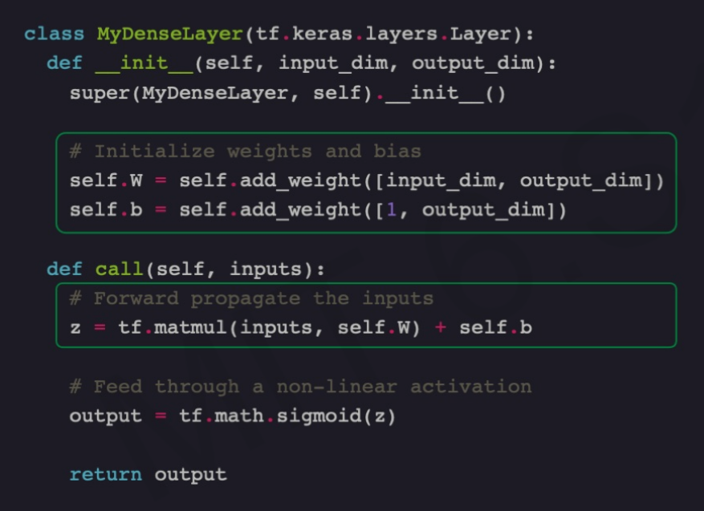

Structure of the Neuron
$$z=g(\sum{x ∗w )}$$

Slide 12
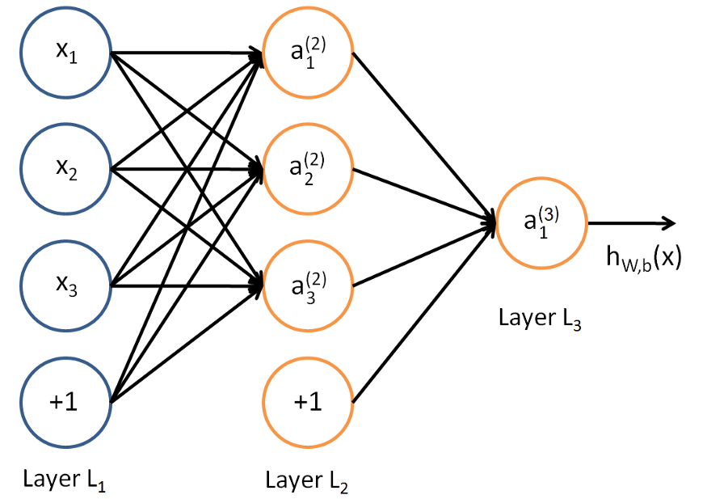
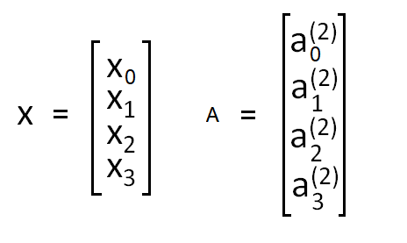
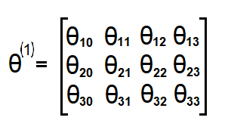
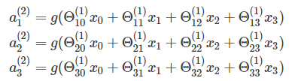
Structure of the Neuron

Slide 13
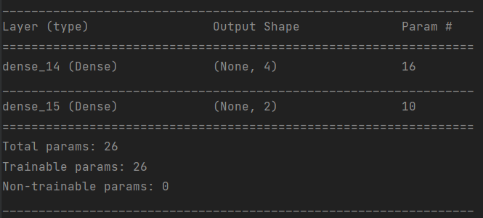
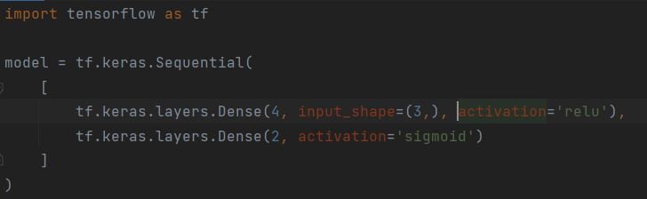
Neural Network

Slide 14
Types of Neural Network
Feed Forward Neural Network:
Multi layer perceptron (MLP)
Convolutional Neural Network (CNN)
Recurrent Neural Network (RNN)

Slide 15
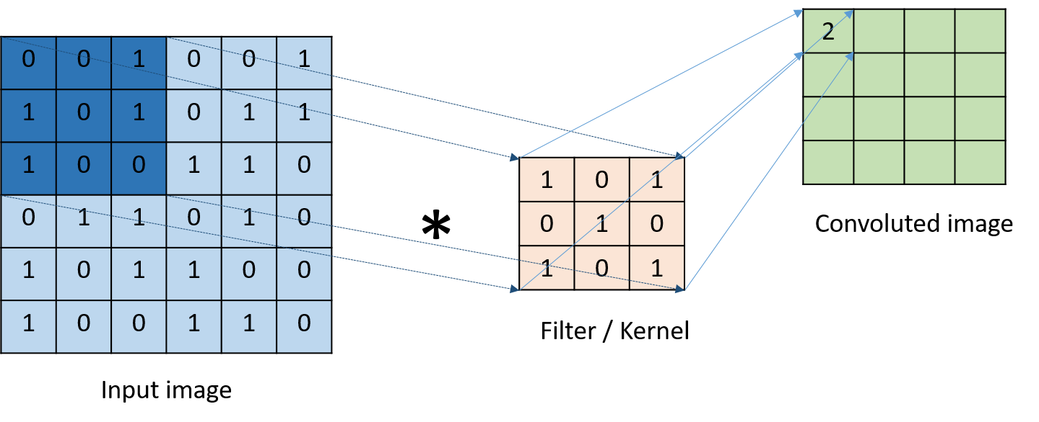
Types of layers
Convolution:
Change of dimension with convolution operation
Image size: [n × n]
Filter size: [f × f]
Result image size: [(n − f + 1) × (n − f + 1)]

Slide 16
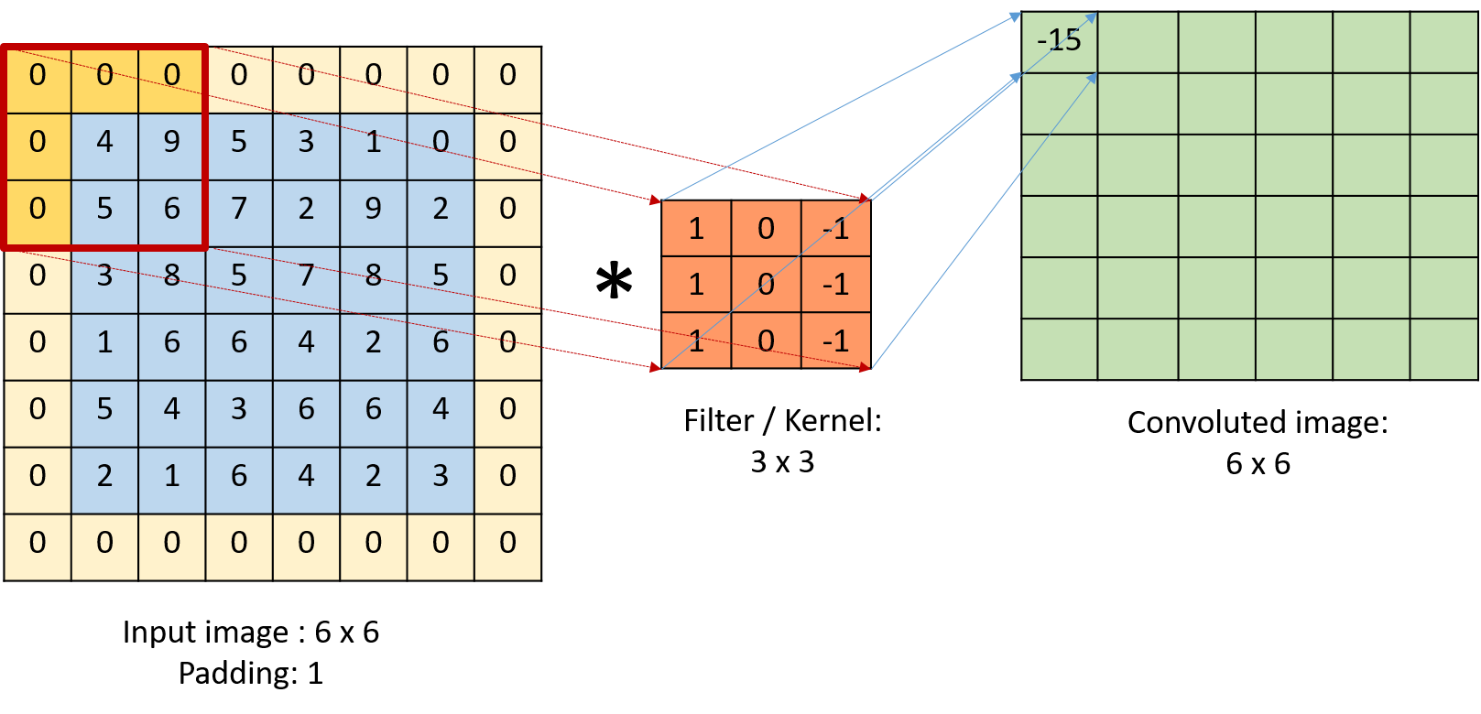
Types of layers
Padded convolution:

Slide 17
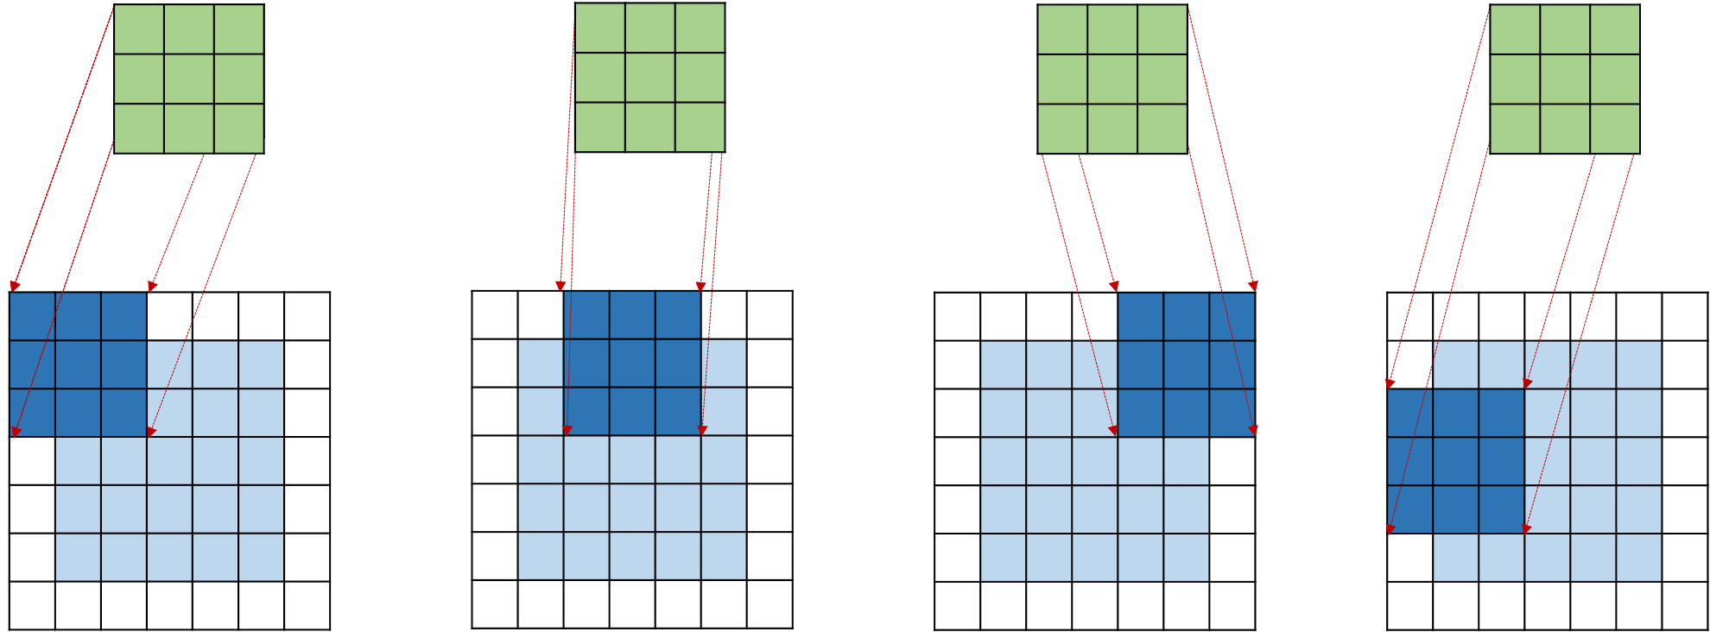
Types of layers
Strided convolution:

Slide 18
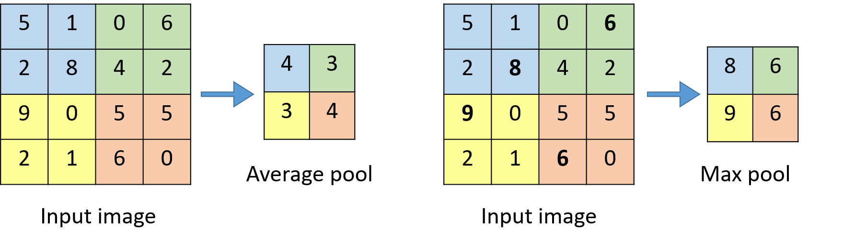
Types of layers
Pooling layer:

Slide 19
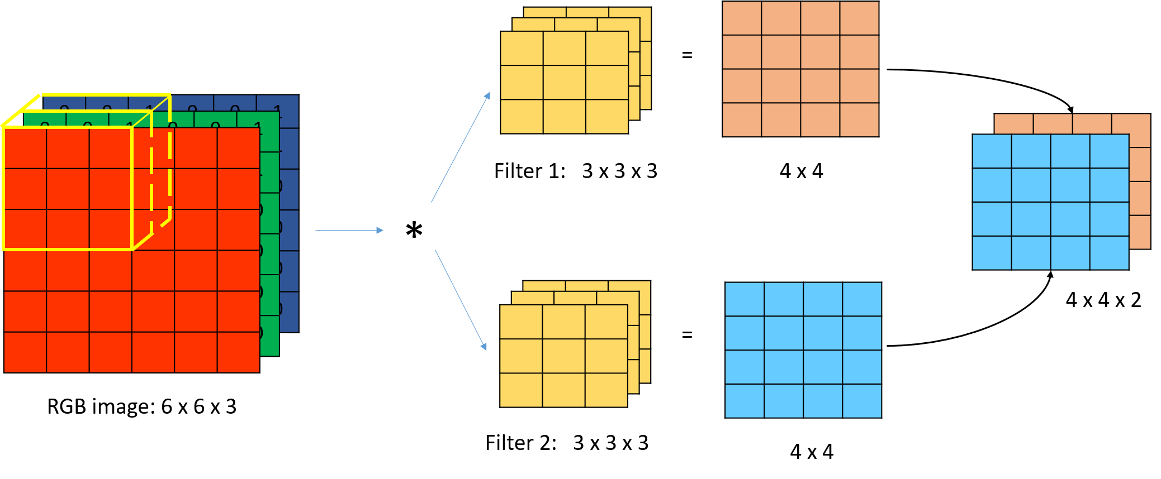
Convolution Neural Network
3D Convolution

Slide 20

Convolution Neural Network
VGG16 network

Slide 21
Convolution Neural Network
VGG16 network implementation in python

Slide 22
Convolution Neural Network
Visualization of activations in CNN

Slide 23
Questions?

